Slide 1
Assistive Technologies
What we need to know

Slide 2
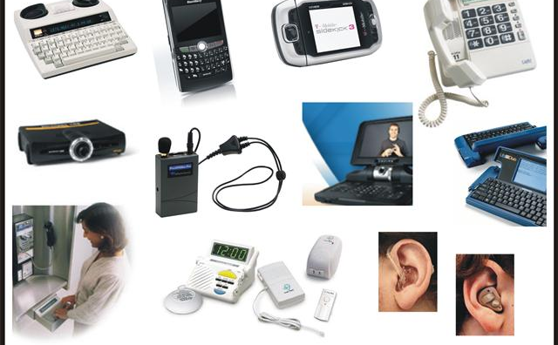
http://literacy.purduecal.edu/STUDENT/ktracy20/hearingat.html
Assistive Technology is an umbrella term that includes assistive, adaptive, and rehabilitative devices for people with disabilities and also includes the process used in selecting, locating, and using them. AT promotes greater independence by enabling people to perform tasks that they were formerly unable to accomplish, or had great difficulty accomplishing, by providing enhancements to, or changing methods of interacting with, the technology needed to accomplish such tasks.

Slide 3
Assistive vs Adaptive Technologies
http://youtu.be/DB9pKkZoJDc
The term Adaptive Technology is often used as the synonym for Assistive Technology, however, they are different terms. Assistive Technology refers to "any item, piece of equipment, or product system, whether acquired commercially, modified, or customized, that is used to increase, maintain, or improve functional capabilities of individuals with disabilities," while Adaptive Technology covers items that are specifically designed for persons with disabilities and would seldom be used by non-disabled persons. In other words, "Assistive Technology is any object or system that increases or maintains the capabilities of people with disabilities," while Adaptive Technology is "any object or system that is specifically designed for the purpose of increasing or maintaining the capabilities of people with disabilities." Consequently, Adaptive Technology is a subset of Assistive Technology. Adaptive Technology often refers specifically to electronic and Information Technology access.

Slide 4
Assistive Technology for visual impairment
Many people with serious visual impairments live independently, using a wide range of tools and techniques. Examples of Assistive Technology for visually impairment include the Canadian currency tactile feature which a system of raised dots in one corner, based on Braille cells but not standard Braille. For general computer use access technology such as screen readers, screen magnifiers and refreshable Braille displays has been widely taken up along with standalone reading aids that integrate a scanner, optical character recognition (OCR) software, and speech software in a single machine. These function together without a separate PC.
http://www.youtube.com/watch?v=IcUNnnwFm4g

Slide 5
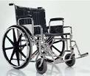
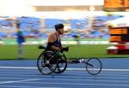
Mobility impairment and wheelchairs
Wheelchairs are devices that can be manually propelled or electrically propelled and that include a seating system and are designed to be a substitute for the normal mobility that most people enjoy. Wheelchairs and other mobility devices allow people to perform mobility related Activities of Daily Living which include feeding, toileting, dressing grooming and bathing. The devices comes in a number of variations where they can be propelled either by hand or by motors where the occupant uses electrical controls to manage motors and seating control actuators through a joystick or other input devices. Often there are handles behind the seat for someone else to do the pushing or input devices for caregivers. Wheelchairs are used by people for whom walking is difficult or impossible due to illness, injury, or disability. People with both sitting and walking disability often need to use a wheelchair or walker.
Sports variants
A modern racing wheelchair

Slide 6
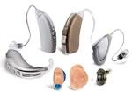
Hearing Aids
A hearing aid is an electroacoustic device which is designed to amplify sound for the wearer, usually with the aim of making speech more intelligible, and to correct impaired hearing as measured by audiometry.
Types:
Behind the ear aids- Behind the ear aids consist of a case, an earmold or dome and a connection between them. The case contains the electronics, controls, battery, microphone(s) and often the loudspeaker. Generally, the case sits behind the pinna with the connection from the case coming down the front into the ear. The sound from the instrument can be routed acoustically or electrically to the ear. If the sound is routed electrically, the speaker (receiver) is located in the earmold or an open-fit dome, while acoustically coupled instruments use a plastic tube to deliver the sound from the case’s loudspeaker to the earmold. BTEs can be used for mild to profound hearing loss
In the ear aids (ITE)- These devices fit in the outer ear bowl (called the concha) they are sometimes visible when standing face to face with someone. ITE hearing aids are custom made to fit each individual's ear. They can be used in mild to some severe hearing losses.
Invisible in canal hearing aids (IIC)- This style of hearing aids fits inside the ear canal completely, leaving little to no trace of an installed hearing aid visible. This is because it fits deeper in the canal than other types, so that it is out of view even when looking directly into the ear bowl (concha). Unlike other hearing aid types, with the IIC aid the majority of the ear is not blocked (occluded) by a large plastic shell. This means that sound can be collected more naturally by the shape of the ear, and can travel down into the ear canal as it would with unassisted hearing.

Slide 7
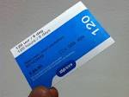
Accessibility software
In human–computer interaction, computer accessibility (also known as Accessible computing) refers to the accessibility of a computer system to all people, regardless of disability or severity of impairment, examples include Web accessibility guidelines. Another approach is for the user to present a token to the computer terminal, such as a smart card, that has configuration information to adjust the computer speed, text size, etc. to their particular needs. This is useful where users want to access public computer based terminals in Libraries, ATM, Information kiosks etc. The concept is encompassed by the CEN EN 1332-4 Identification Card Systems - Man-Machine Interface. This development of this standard has been supported in Europe by SNAPI and has been successfully incorporated into the Lasseo specifications, but with limited success due to the lack of interest from public computer terminal suppliers.

Slide 8
Apple and Education “We’ve done everything possible to make anything possible.”
iPhone, iPad, and iPod touch come with assistive features that have changed the learning landscape for students with special needs.
Guided Access(Learning and Literacy)
Guided Access helps students with autism or other attention and sensory challenges stay on task. A teacher or therapist can limit an iOS device to stay on one app by disabling the Home button, and even restrict touch input on certain areas of the screen. So wandering taps and gestures won’t distract from learning.
VoiceOver(Vision)
VoiceOver is a gesture-based screen reader that lets students know what’s happening on their Multi-Touch screen — and helps them navigate it — even if they can’t see it. Students can triple-click the Home button wherever they are in iOS to access VoiceOver. They can hear a description of everything happening on the screen, so they can know which app their finger is on, find a passage in an essay, or have an ebook read aloud. Students can adjust the VoiceOver speaking rate and pitch to just how they want it.
AssistiveTouch(Physical and motor skills)
iOS devices feature high-precision, touch-sensitive displays that require no physical force, just simple contact with the surface. And AssistiveTouch allows students with limited motor capabilities to adapt the Multi-Touch screen of their iOS device to their needs. So more complicated Multi-Touch gestures, like a pinch or multifinger swipe, are accessible with just the tap of a finger. Or students can create custom gestures. And if they have trouble pressing the Home button, they can activate it with an onscreen tap. Gestures like rotate and shake are available even if the iOS device is mounted on a wheelchair. And for students who need assistive devices such as joysticks, iOS devices also support a number of third-party options

Slide 9
A higher percentage of children and youth ages 3–21 received special education services under IDEA for specific learning disabilities than for any other type of disability in 2011–12. A specific learning disability is a disorder in one or more of the basic psychological processes involved in understanding or using language, spoken or written, that may manifest itself in an imperfect ability to listen, think, speak, read, write, spell, or do mathematical calculations. In 2011–12, some 36 percent of all children and youth receiving special education services had specific learning disabilities, 21 percent had speech or language impairments, and 12 percent had other health impairments (includes having limited strength, vitality, or alertness due to chronic or acute health problems such as a heart condition, tuberculosis, rheumatic fever, nephritis, asthma, sickle cell anemia, hemophilia, epilepsy, lead poisoning, leukemia, or diabetes). Students with autism, intellectual disabilities, developmental delay, and emotional disturbances each accounted for between 6 and 7 percent of children and youth served under IDEA. Children and youth with multiple disabilities, hearing impairments, orthopedic impairments, visual impairments, traumatic brain injury, and deaf-blindness each accounted for 2 percent or less of those served under IDEA.

Slide 10
Resources
http://literacy.purduecal.edu/STUDENT/ktracy20/hearingat.html
Youtube.com (http://youtu.be/DB9pKkZoJDc, www.youtube.com/watch?v=IcUNnnwFm4g,
http://www.spectrumgenerations.org/hearing-aid-cooperative
www.Apple.com
http://www.flickr.com/photos/jennycu/4488977858/
http://www.flickr.com/photos/thelebers/5768766825/
https://nces.ed.gov/programs/coe/indicator_cgg.asp

